Slide 1

Wi-Fi + ARM + AXI + FPGA : from the I/O pin to the internet
October 26, 2016

Slide 2
Power Supplies
LEDs
Boot Media
Wireless
Application Processor
Reconfigurable I/O
Programmable Logic

Slide 3
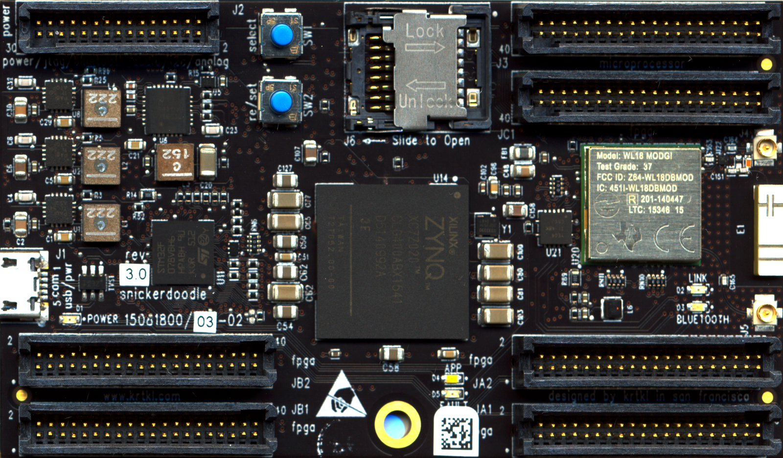
J2
J3
JC1
J1
JB2
JA2
JB1
JA1

Slide 4
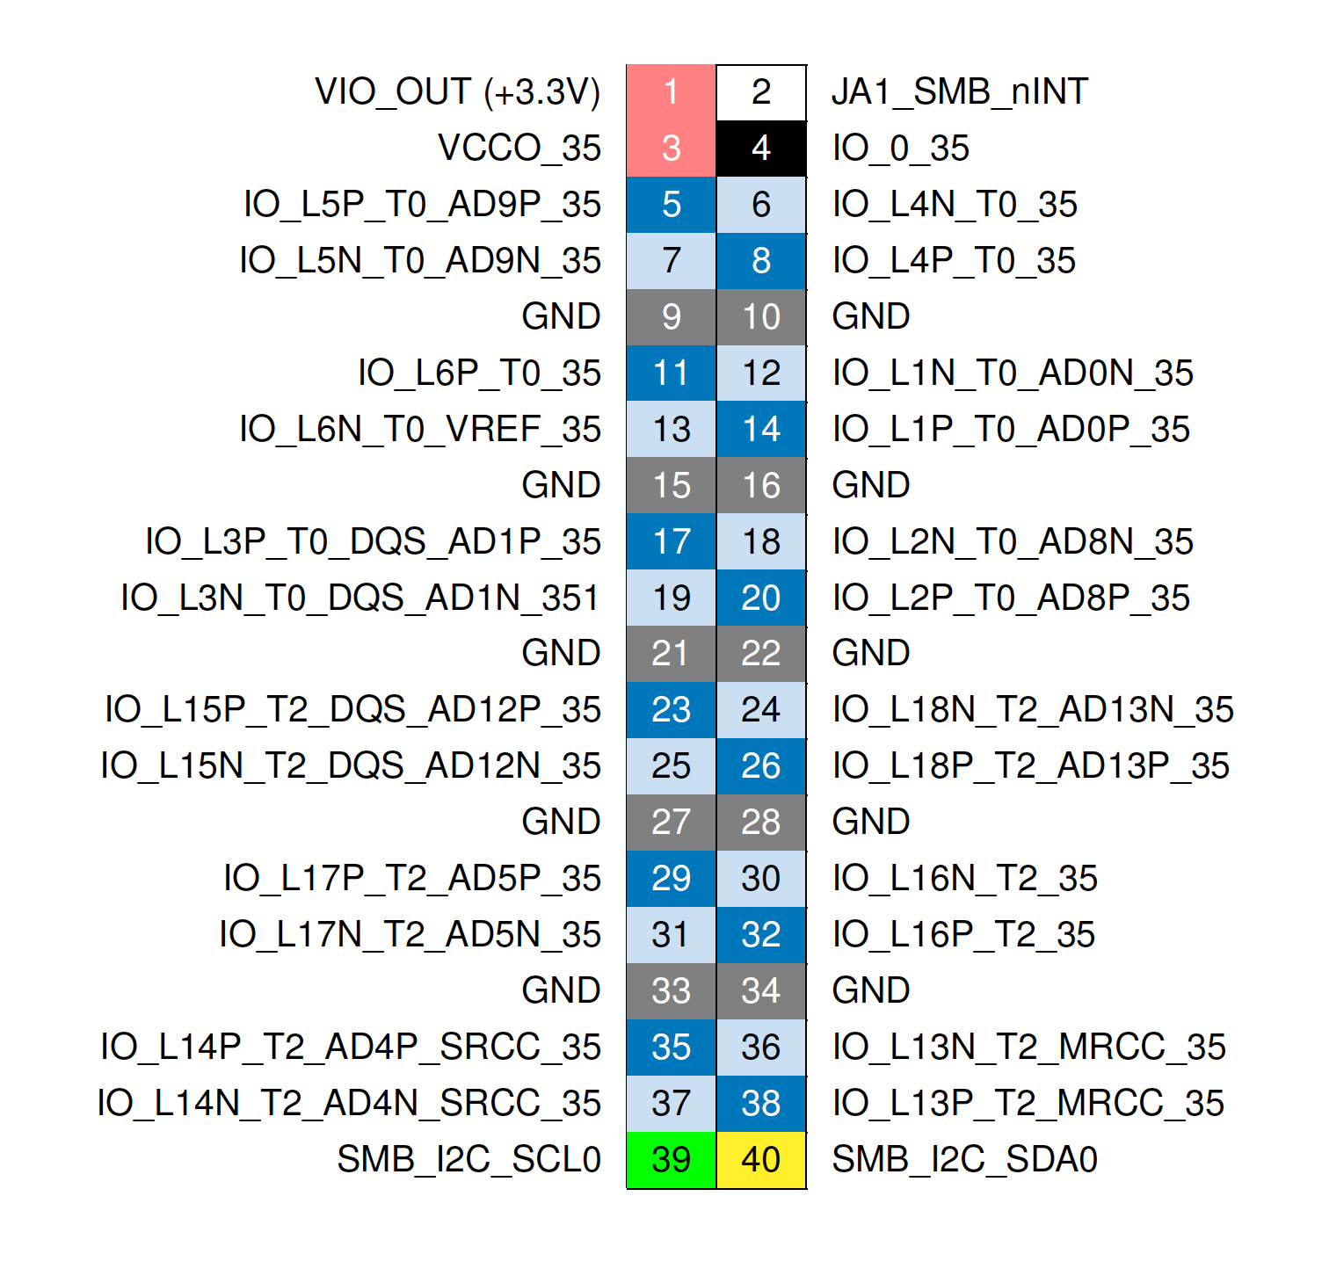
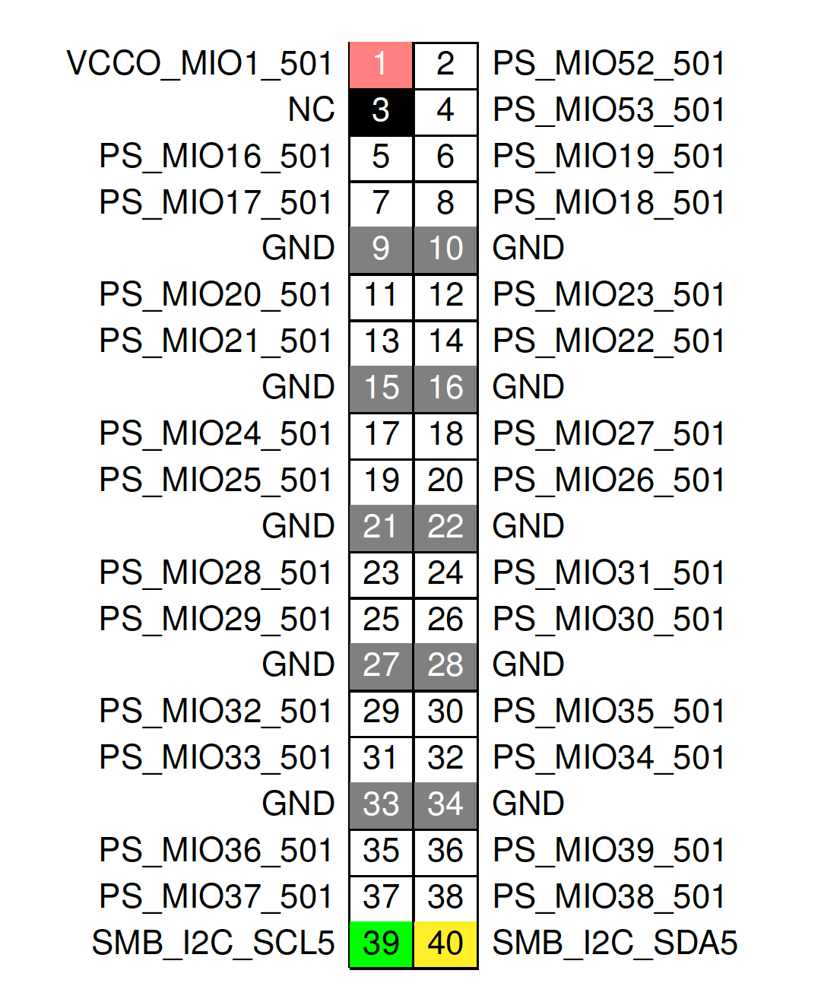
FPGA Connectivity
PS Connectivity
I/O Bank VREF
FPGA I/O

Slide 5
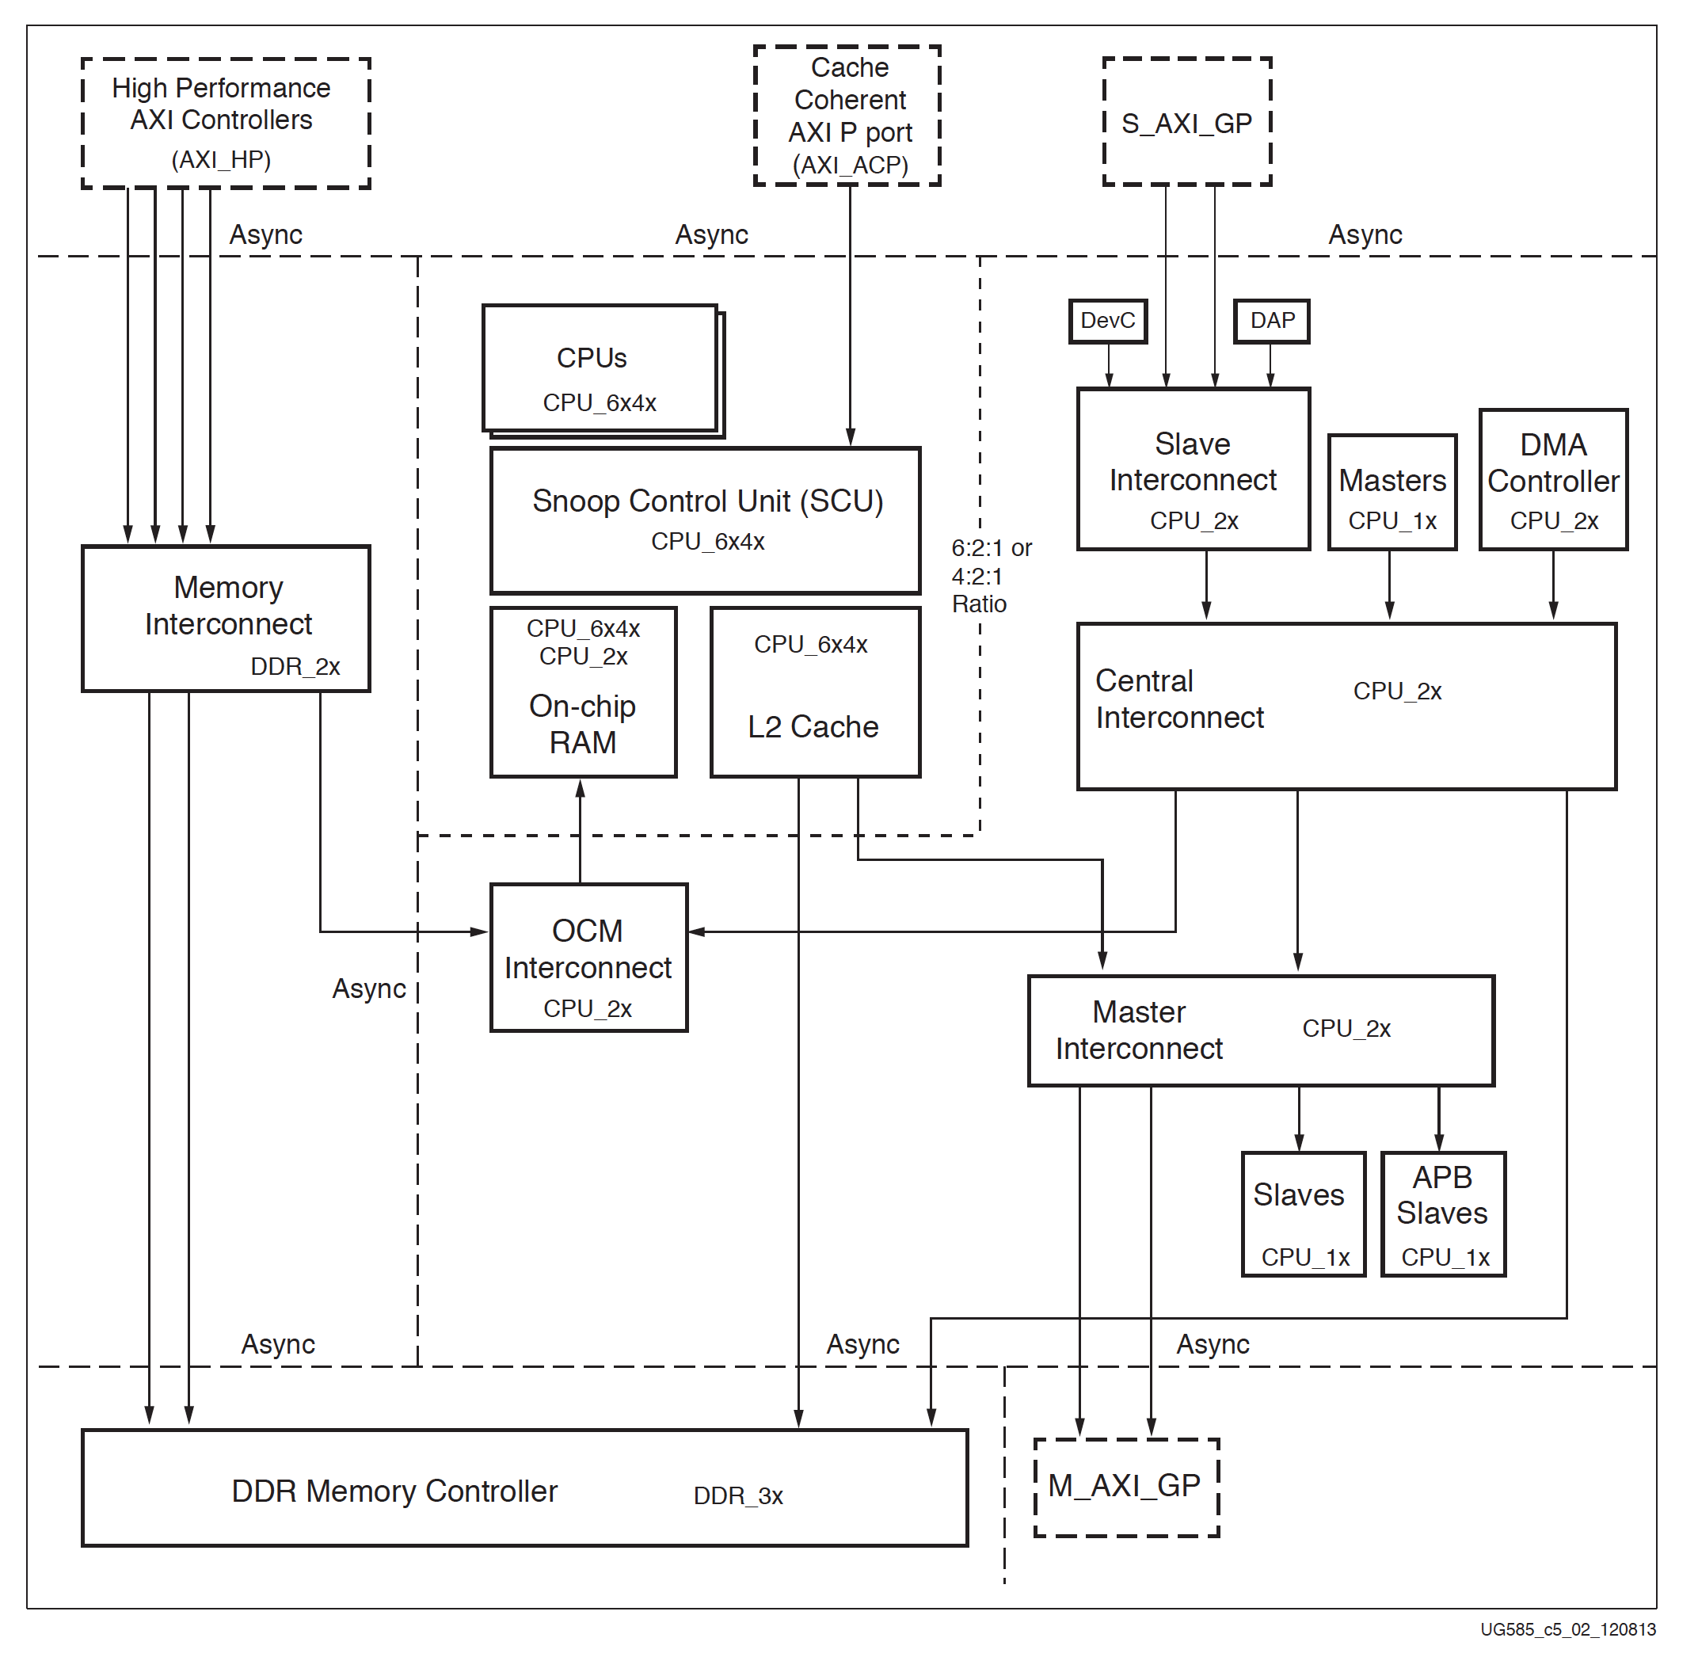
Zynq-7000 AP SoC Technical Reference Manual
UG585 (v1.10) February 23, 2015

Slide 6
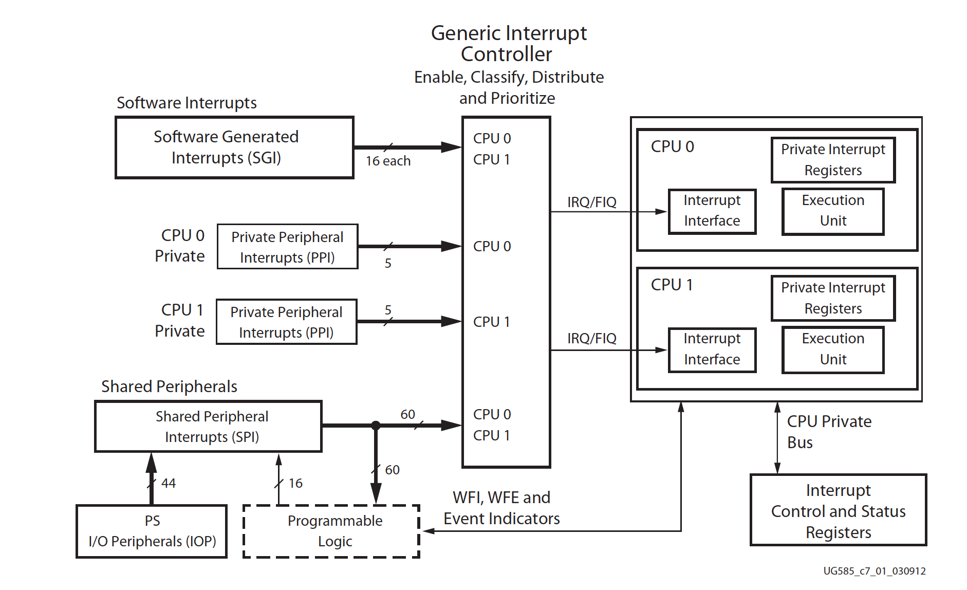
Zynq-7000 AP SoC Technical Reference Manual
UG585 (v1.10) February 23, 2015

Slide 7
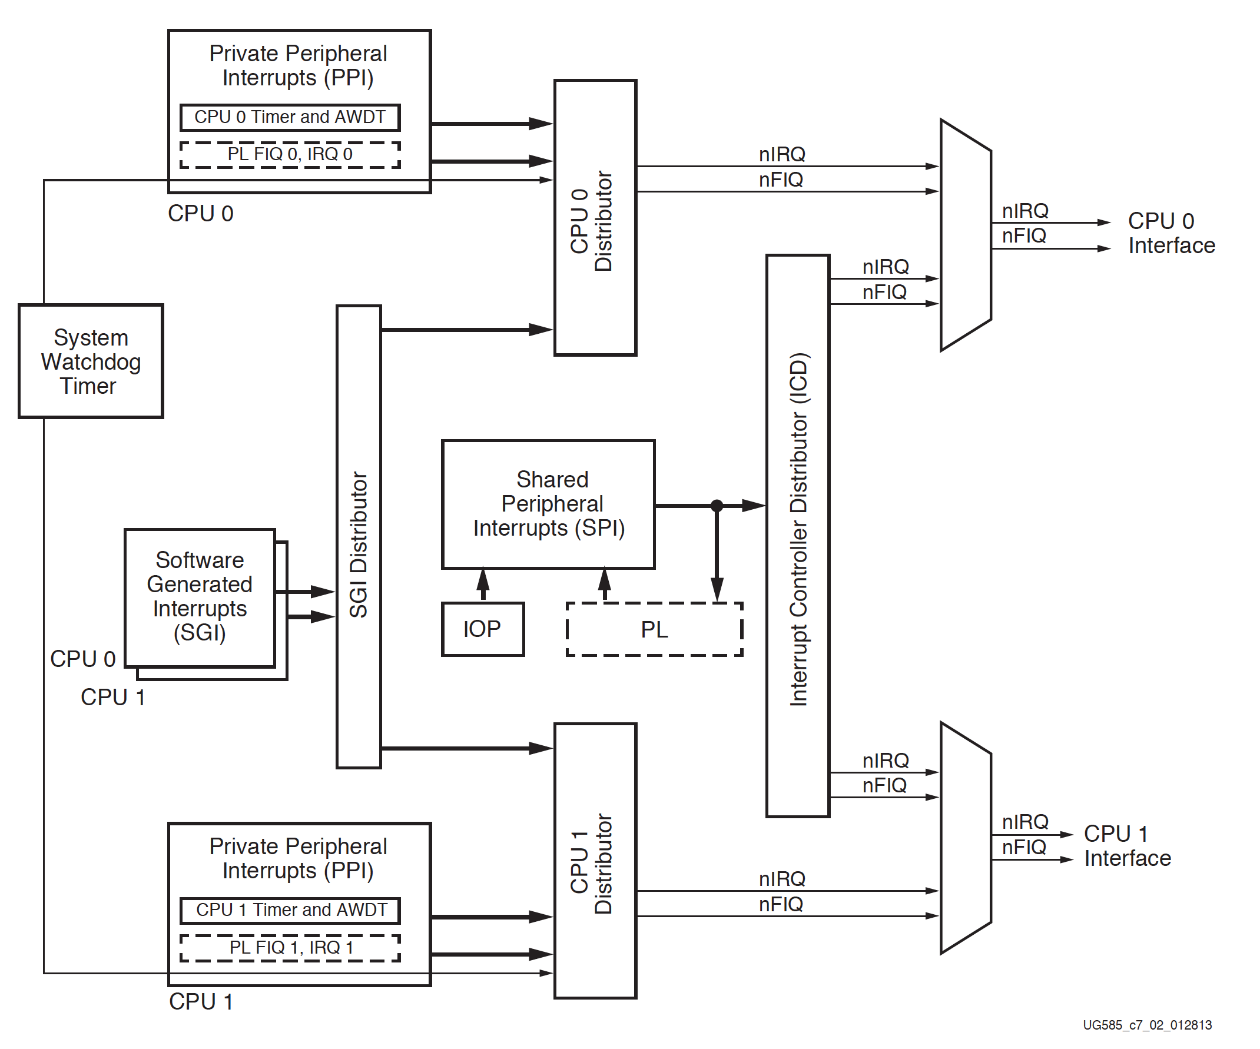
Zynq-7000 AP SoC Technical Reference Manual
UG585 (v1.10) February 23, 2015

